Slide 1

DEPARTMENT OF INDUSTRIAL MANAGEMENT
FACULTY OF SCIENCE | UNIVERSITY OF KELANIYA
Mobile UI Design Patterns, Navigation & Material Components
Android Fundamentals — UI Design Patterns
Part 1 — Foundations: Views, Layouts & Events
Part 2 — Moving Between Screens: Intents & Data
Part 3 — Material Design & Responsive Layout
Part 4 — Structuring App-Wide Navigation
Part 5 — Displaying Data at Scale: Lists
Sammani Maddumahewage · Lecturer (Probationary) · BSc (Hons) in Information Technology

Slide 2

PART 1 · FOUNDATIONS: VIEWS, LAYOUTS & EVENTS
Views & Layouts: Building the Login Screen
The Building Blocks
The Login Screen in XML
Layouts
Containers that control how everything inside them is positioned.
LinearLayout, ConstraintLayout
Views
The interactive components the user actually sees and touches.
TextView, EditText, Button
Every screen we build today starts the same way: a layout in XML, holding views. We'll use this Login screen as our running example for the rest of the lecture.
<LinearLayout
android:layout_width="match_parent"
android:layout_height="match_parent"
android:orientation="vertical"
android:padding="24dp">
<EditText
android:id="@+id/etUsername"
android:hint="Username" />
<EditText
android:id="@+id/etPassword"
android:hint="Password"
android:inputType="textPassword" />
<Button
android:id="@+id/btnLogin"
android:text="Login" />
</LinearLayout>
Part progress 1 / 16

Slide 3
PART 1 · FOUNDATIONS: VIEWS, LAYOUTS & EVENTS
Making the UI Interactive: Event Handling
How Android Responds to the User
Wiring Up the Login Button
The XML we just wrote is silent — tapping Login does nothing until we attach Kotlin code to it.
Step 1 — Find the view:
loginButton.setOnClickListener {
val user = username.text.toString()
val pass = password.text.toString()
if (user.isNotEmpty() && pass.isNotEmpty()) {
Toast.makeText(this, "Login Successful",
Toast.LENGTH_SHORT).show()
} else {
Toast.makeText(this, "Please enter all fields",
Toast.LENGTH_SHORT).show()
}
}
val username = findViewById<EditText>(R.id.etUsername)
val password = findViewById<EditText>(R.id.etPassword)
val loginButton = findViewById<Button>(R.id.btnLogin)
Step 2 — Every event follows the same flow:
User Action → Event Generated → Listener Activated → Code Executed → UI Feedback
Without this pattern, the UI is static and the app is non-interactive. It's the single idea behind every button, menu, and list item we'll wire up for the rest of the lecture.
Part progress 2 / 16

Slide 4
PART 2 · MOVING BETWEEN SCREENS: INTENTS & DATA
Navigating With Explicit Intents
What Is an Intent?
From Login to Home
A validated login is only useful if it takes the user somewhere. An Intent is the messaging object that makes that jump happen.
An explicit Intent names both:
The current Activity (context) — this
The target Activity class — HomeActivity::class.java
The same pattern links Login to a Registration screen, and back again:
// Continues the Login button's click listener
if (isValidUser) {
val intent = Intent(this, HomeActivity::class.java)
startActivity(intent)
}
// Login -> Registration
btnGoToRegister.setOnClickListener {
val intent = Intent(this, RegisterActivity::class.java)
startActivity(intent)
}
// Registration -> Login
tvLoginLink.setOnClickListener { finish() }
Part progress 3 / 16

Slide 5
PART 2 · MOVING BETWEEN SCREENS: INTENTS & DATA
Passing & Receiving Data Between Activities
Sending Data on the Way Out
Reading Data on the Way In
// Just before startActivity(intent) on the Login screen
intent.putExtra("USERNAME", username)
startActivity(intent)
// Inside HomeActivity.onCreate()
val username = intent.getStringExtra("USERNAME")
tvWelcome.text = "Welcome $username"
putExtra() attaches key–value data to the Intent — here, the username the person just logged in with.
This is the same Intent from the previous slide; we're simply adding a payload to it before it launches HomeActivity.
getStringExtra() reads the value back out by the same key used in putExtra().
This send-and-receive pattern enables:
Personalization of the next screen
Context sharing between Activities
Dynamic UI updates driven by real data
Part progress 4 / 16

Slide 6
PART 3 · MATERIAL DESIGN & RESPONSIVE LAYOUT
Material Design: The Principles Behind Android's UI
Three Foundational Principles
Why a Plain EditText Isn't Enough
1. Material is Metaphorical
Components behave like physical objects — buttons look pressable, cards look elevated.
2. Bold, Intentional Design
Clear typography and meaningful color make primary actions and errors stand out.
3. Motion Provides Meaning
Ripples and transitions — like the one between our Login and Registration screens — guide attention and confirm cause and effect.
<EditText
android:hint="Email" />
A traditional EditText:
Has no built-in error handling
Looks plain, with no visual feedback
Material Design introduces TextInputLayout, which wraps EditText and applies all three principles above at once — that's what we build next.
Part progress 5 / 16

Slide 7
PART 3 · MATERIAL DESIGN & RESPONSIVE LAYOUT
Material Components in Practice
Email Field
Password Field, With a Visibility Toggle
<com.google.android.material.textfield.
TextInputLayout
android:layout_width="match_parent"
android:layout_height="wrap_content"
android:hint="Email Address">
<com.google.android.material.textfield.
TextInputEditText
android:id="@+id/etEmail"
android:layout_width="match_parent"
android:layout_height="wrap_content"
android:inputType="textEmailAddress"/>
</com.google.android.material.textfield.
TextInputLayout>
<com.google.android.material.textfield.
TextInputLayout
android:layout_width="match_parent"
android:layout_height="wrap_content"
app:endIconMode="password_toggle"
android:hint="Password">
<com.google.android.material.textfield.
TextInputEditText
android:id="@+id/etPassword"
android:layout_width="match_parent"
android:layout_height="wrap_content"
android:inputType="textPassword"/>
</com.google.android.material.textfield.
TextInputLayout>
app:endIconMode="password_toggle" adds a show/hide eye icon for free — no extra Kotlin code needed.
Part progress 6 / 16

Slide 8
PART 3 · MATERIAL DESIGN & RESPONSIVE LAYOUT
Designing for Every Screen: Responsive Layout
What Responsive UI Must Do
Techniques We're Already Using
Every screen we design has to keep working as conditions change:
Work correctly on every screen size
Support orientation changes
Remain accessible at any density
Getting this right is what lets the same Login layout we built in Part 1 look correct on a small phone and a large tablet alike.
Prefer ConstraintLayout over fixed positioning for complex screens
Avoid fixed pixel dimensions
Size spacing with dp, and text with sp
Test on multiple device configurations before shipping
android:padding="24dp" <!-- spacing: dp -->
android:textSize="16sp" <!-- text: sp -->
Part progress 7 / 16

Slide 9
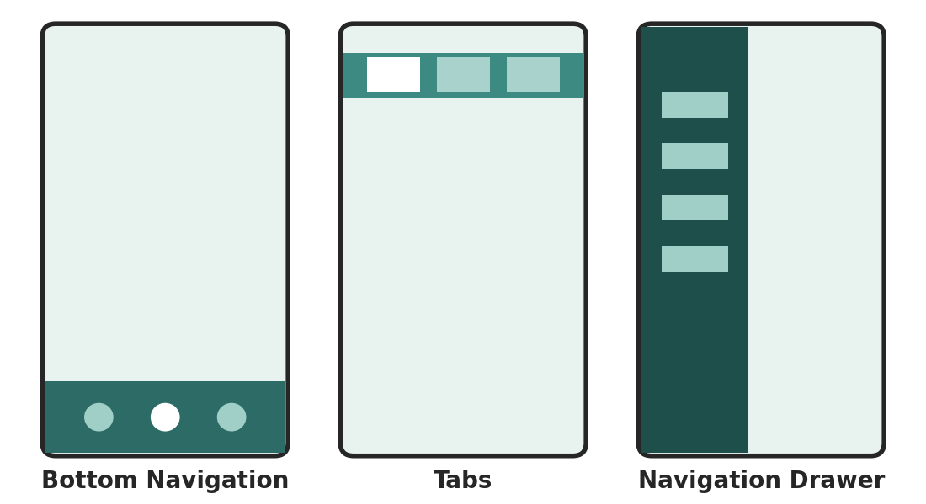
PART 4 · STRUCTURING APP-WIDE NAVIGATION
Choosing an App-Wide Navigation Structure
So far every screen has stood alone. A real app needs a consistent way for users to move between all of its top-level destinations.
Bottom Navigation — best for 3–5 destinations used frequently
Tabs — best for switching between related views of the same data
Navigation Drawer — best for many destinations, including infrequent ones
A Top App Bar (Toolbar) sits above all three — we'll build that first.
Part progress 8 / 16

Slide 10
PART 4 · STRUCTURING APP-WIDE NAVIGATION
Top Navigation: The Toolbar
Toolbar & Menu XML
Handling Menu Clicks in Kotlin
<com.google.android.material.appbar.
MaterialToolbar
android:id="@+id/toolbar"
android:layout_width="match_parent"
android:layout_height="wrap_content"
android:title="Home"
app:menu="@menu/top_menu"/>
<!-- res/menu/top_menu.xml -->
<menu xmlns:android="...">
<item
android:id="@+id/action_logout"
android:title="Logout"
android:showAsAction="always"/>
</menu>
toolbar.setOnMenuItemClickListener {
if (it.itemId == R.id.action_logout) {
finish()
true
} else false
}
The Toolbar:
Displays the current screen title
Holds action items, like the Logout button above
Provides consistent branding across screens
Right now, tapping Logout calls finish() immediately — one accidental tap logs the user out. Let's fix that.
Part progress 9 / 16

Slide 11
PART 4 · STRUCTURING APP-WIDE NAVIGATION
Confirming Actions: Dialogs & Alerts
Guarding the Logout Action
Why Dialogs Matter
// Replaces the bare finish() call from the Toolbar's
// logout handler on the previous slide
AlertDialog.Builder(this)
.setTitle("Logout")
.setMessage("Do you want to logout?")
.setPositiveButton("Yes") { _, _ -> finish() }
.setNegativeButton("No", null)
.show()
Dialogs are used to:
Confirm a destructive or important action, like logging out
Display warnings before something irreversible happens
Show short-lived information without leaving the current screen
setPositiveButton and setNegativeButton each take a lambda that only runs when that button is tapped. setNegativeButton("No", null) simply dismisses the dialog.
Part progress 10 / 16

Slide 12
PART 4 · STRUCTURING APP-WIDE NAVIGATION
Bottom Navigation
XML & Menu
Handling Selection
<com.google.android.material.
bottomnavigation.BottomNavigationView
android:id="@+id/bottomNavigation"
android:layout_width="match_parent"
android:layout_height="wrap_content"
app:menu="@menu/bottom_menu"/>
<!-- res/menu/bottom_menu.xml -->
<menu xmlns:android="...">
<item android:id="@+id/nav_home"
android:title="Home"/>
<item android:id="@+id/nav_users"
android:title="Users"/>
</menu>
bottomNavigation.setOnItemSelectedListener {
when (it.itemId) {
R.id.nav_home -> true
R.id.nav_users -> true
else -> false
}
}
Bottom Navigation:
Gives quick access to top-level destinations
Designed for 3–5 sections, not more
The most common pattern in modern Android apps
Part progress 11 / 16

Slide 13
PART 4 · STRUCTURING APP-WIDE NAVIGATION
Navigation Drawer (Left Panel)
DrawerLayout Structure
When to Use a Drawer
<androidx.drawerlayout.widget.DrawerLayout>
<FrameLayout
android:id="@+id/container"/>
<com.google.android.material.navigation.
NavigationView
app:menu="@menu/drawer_menu"
android:layout_gravity="start"/>
</androidx.drawerlayout.widget.DrawerLayout>
The Navigation Drawer:
Slides in from the left edge of the screen
Scales well for apps with many features
Best suited to larger, feature-rich apps
The container FrameLayout swaps in whichever screen is selected from the drawer's menu. Swapping content in and out of one container, without creating a new Activity, is exactly the problem Fragments are built to solve.
Part progress 12 / 16

Slide 14
PART 4 · STRUCTURING APP-WIDE NAVIGATION
Scaling Beyond Activities: Why Fragments
The Problem With One Activity Per Screen
The Fragment Solution
We now have a Toolbar, Bottom Navigation, and a Drawer — but if every destination is a full Activity, we pay for it:
Heavy memory usage
Complex navigation logic between screens
Duplicated toolbars, drawers, and bottom nav on every screen
A Fragment represents a portion of the UI, not a whole screen, and lives inside an Activity with its own lifecycle.
Fragments solve the problem by:
Allowing multiple screens to live inside one Activity
Supporting dynamic UI updates without recreating the Activity
Working naturally with the drawer and bottom nav we just built
In practice, used for:
Navigation drawer content panels
Bottom navigation sections
Part progress 13 / 16

Slide 15
PART 5 · DISPLAYING DATA AT SCALE
RecyclerView: Displaying Lists Efficiently
Adapter & ViewHolder
Attaching the RecyclerView
class UserAdapter(private val users: List<String>) :
RecyclerView.Adapter<UserAdapter.UserViewHolder>() {
class UserViewHolder(view: View) :
RecyclerView.ViewHolder(view) {
val name: TextView =
view.findViewById(R.id.tvUserName)
}
override fun onCreateViewHolder(
parent: ViewGroup, viewType: Int
): UserViewHolder {
val view = LayoutInflater.from(parent.context)
.inflate(R.layout.item_user, parent, false)
return UserViewHolder(view)
}
override fun onBindViewHolder(
holder: UserViewHolder, position: Int) {
holder.name.text = users[position]
}
override fun getItemCount(): Int = users.size
}
recyclerView.layoutManager =
LinearLayoutManager(this)
recyclerView.adapter = UserAdapter(userList)
The Users destination we added to the Bottom Navigation menu needs to show a real, scrollable list — this is how.
Four working parts:
RecyclerView — the scrolling container in the layout
Adapter — turns data into rows
ViewHolder — caches each row's view references
LayoutManager — arranges rows (linear, grid, ...)
Part progress 14 / 16

Slide 16
Thank You
Questions?
From a single login screen to a fully navigable, multi-screen app — every piece we built today, in order:
Views & Events → Intents & Data → Material Design → App Navigation → Lists

